Slide 1
GDP + NFL
Nicco Moriates, Cris Paez, Brooklin Heavner, Rianna Keough

Slide 2
Table of Contents
Understanding GDP + NFL
Datasets
Our Questions
Outcomes/Results
GDP + NFL

Slide 3
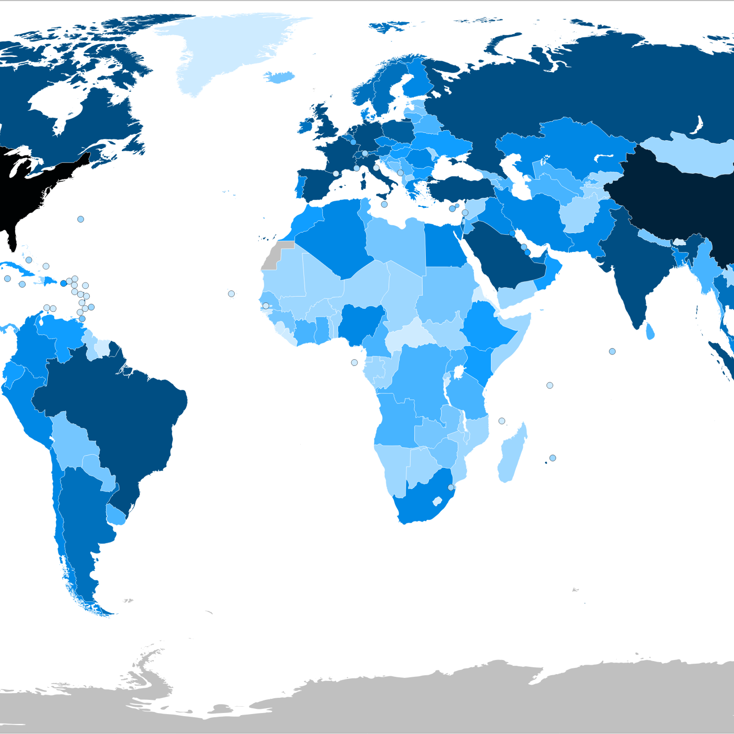
Understanding GDP
1
GDP measures the monetary value of final goods and services produced in a country in a given time period (typically a year). It counts all of the output generated within a country.
GDP is a key indicator of:
Economic growth
Economic forecasts/predictions
Influential economic measure
GDP = C + I + G + NX
GDP + NFL

Slide 4
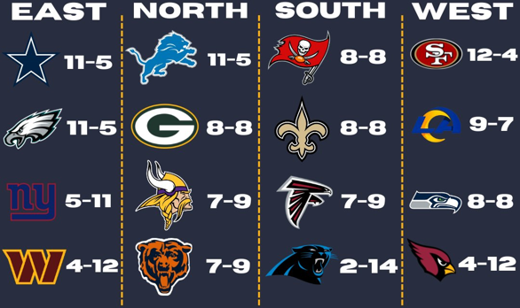
Understanding NFL
1
The NFL, or National Football League, is a professional American organization consisting of 32 teams divided into 8 divisions based on region.
Each team has 53 players with two separate units for offense and defense, each with 11 players on the field at a time.
The goal of offense is to advance the ball toward the opponent’s endzone to score points, while defense’s role is to prevent the opposition from scoring and regain possession of the ball.
GDP + NFL

Slide 5
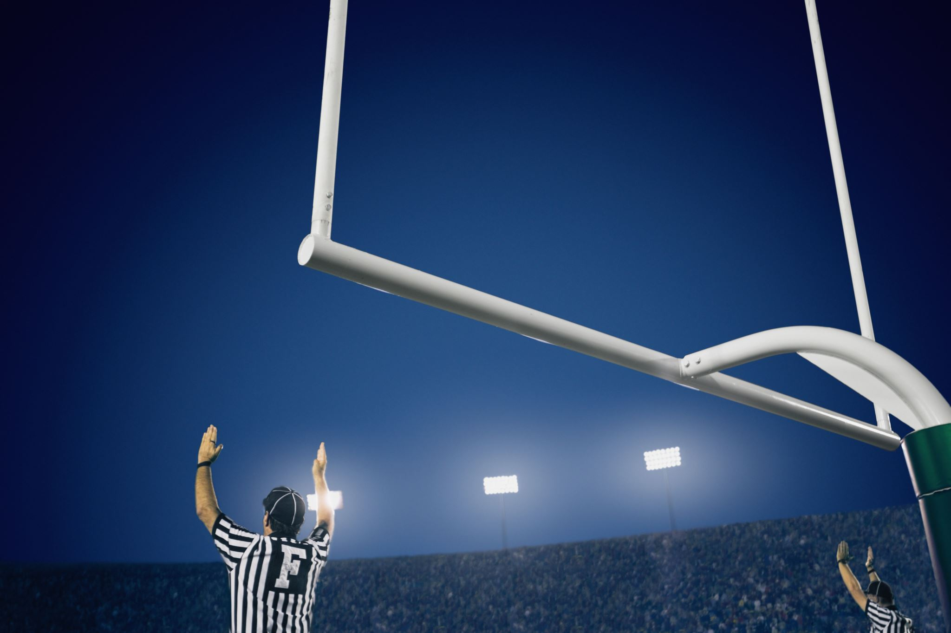
Why GDP + NFL?
1
Consumer Spending on Entertainment
Advertising and Sponsorship Revenue
Media Contracts
Team Investments
Economic Ripple Effects
Predicting Market Trends
GDP + NFL

Slide 6
Our Data
2
Quarterly US GDP Reports
Trillions of current dollars
% change of GDP dollars
Measured from 1947-2018
NFL Team Statistics
Points Scored
Record Percentage
Offensive Total Yards Pass
Measured from 1999-2018

Slide 7
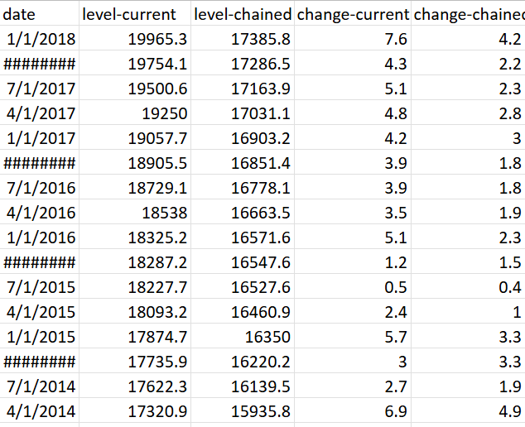
GDP Data
2
285 observations
5 variables
Factors such as
-quarterly/yearly date

Slide 8
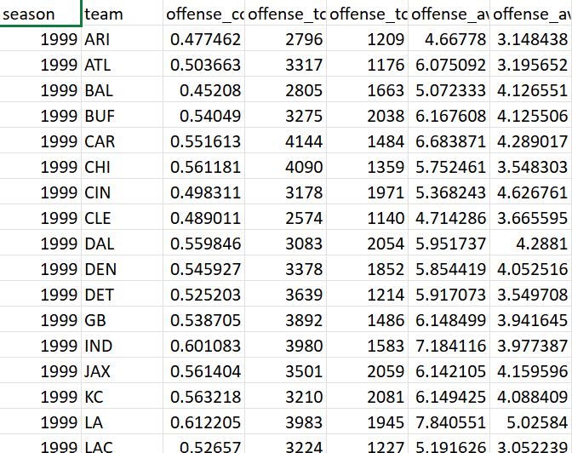
NFL Data
2
765 observations
56 variables
Factors such as yearly data per team

Slide 9
Question 1
3
1. Does the increase in the economy’s strength (GDP measure) result in better-performing football teams (average points score)?
GDP + NFL

Slide 10
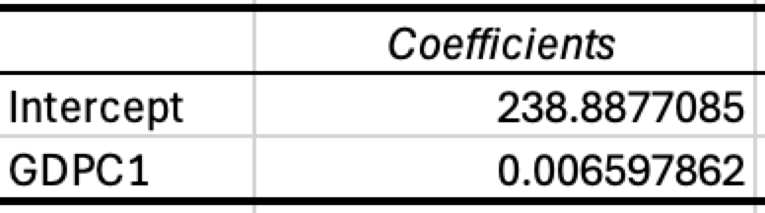
Coaches or Investors?
3
Points scored increases as a result of increasing GDP
R-Square: 0.6887
GDP + NFL

Slide 11
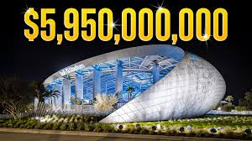
Beauty of Finance in Sports
3
Higher GPD = Healthier economy, Healthier economy = More consumer spending
More consumer spending allows for organizations like the NFL to invest in better facilities, better training, better league analytics, and larger contracts
Dak Prescot (60 M)
GDP + NFL

Slide 12
Question 2
3
2. Did times of financial crises (like the dot com bubble / housing crisis) negatively affect performances of teams?
GDP + NFL

Slide 13
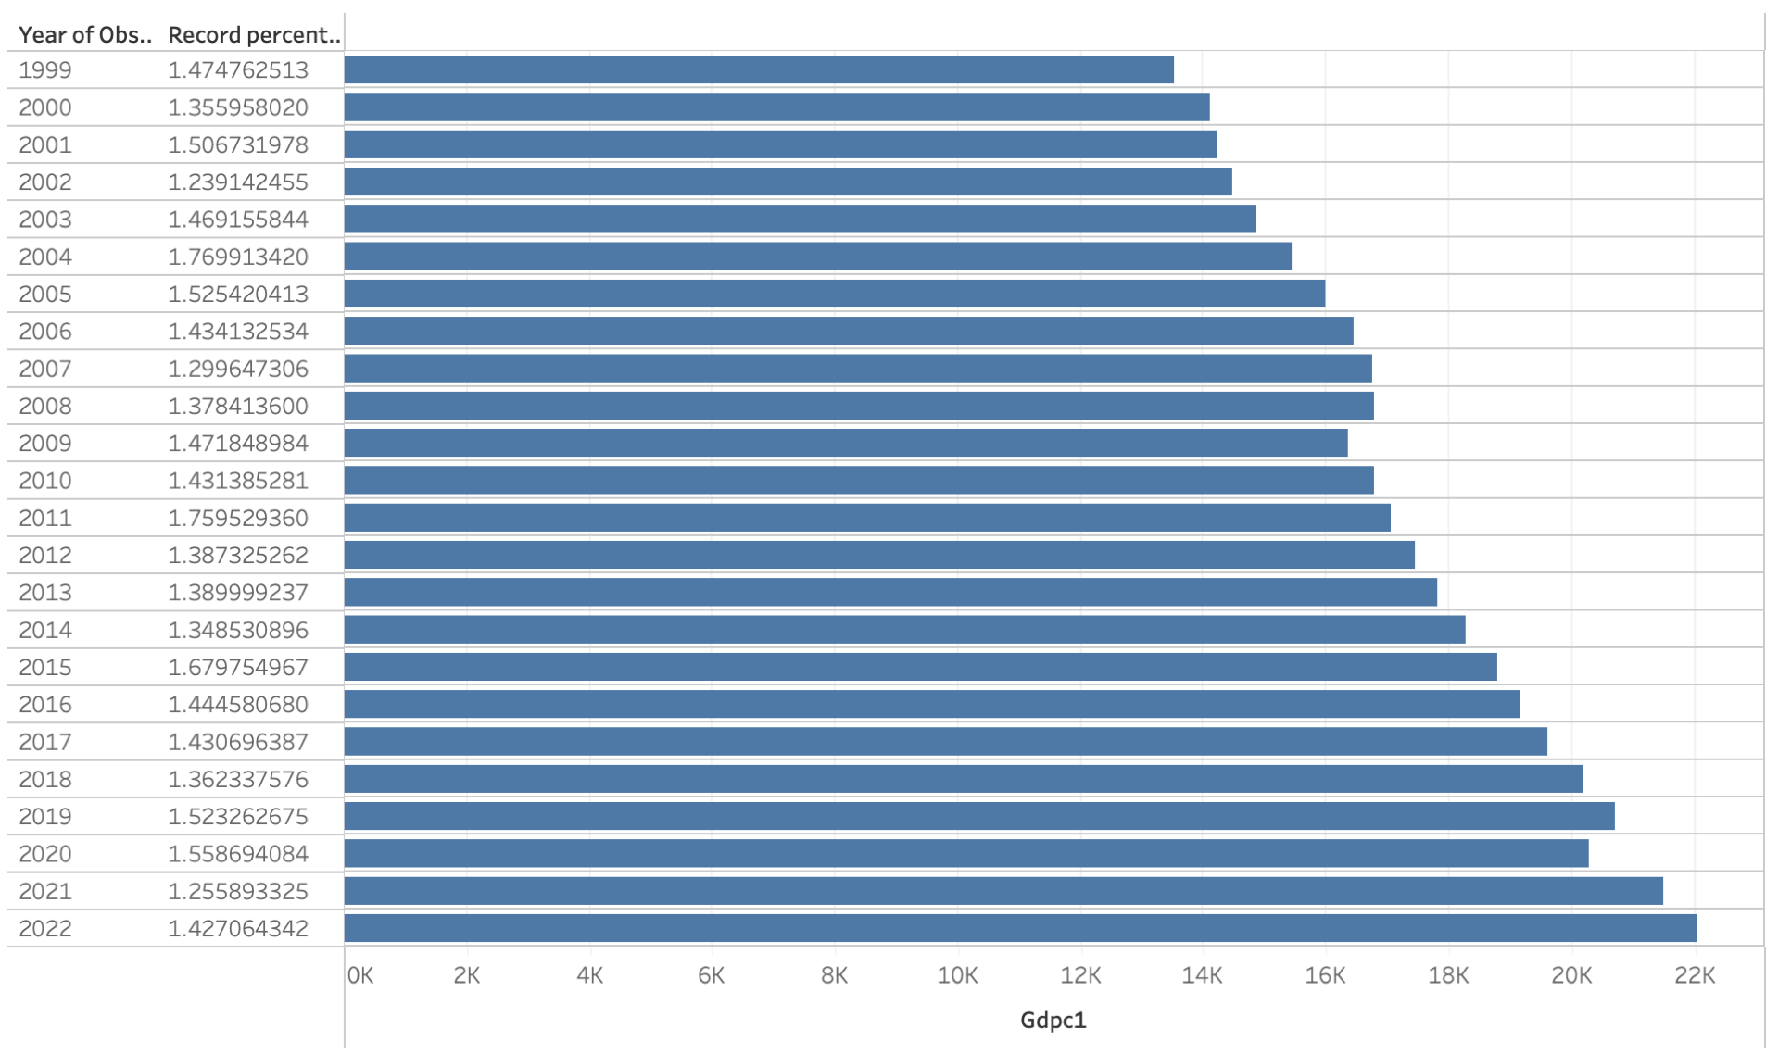
Playing For Something Bigger
3
Record percentages were higher during times of economic distress
Record percentage = W/L
Particularly 2009 (housing crisis) and 2020 (COVID pandemic)
GDP + NFL

Slide 14
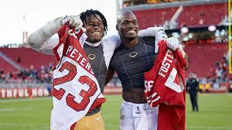
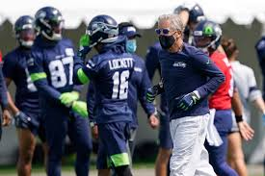
House Calls On and Off the Field
3
According to the NFL, they reported some of their highest viewer ratings during 2008
More free time (unemployment)
Many players were in financial distress
What better wind down than a football game
COVID gave players time to improve their game individually and as a team
Player collabs
Increase in Redzone purchases
More free time for Americans
GDP + NFL

Slide 15
Question 3
3
3. Did specific teams take advantage more than others to their organizations improvement as the economy (GDP) was improving?
GDP + NFL

Slide 16
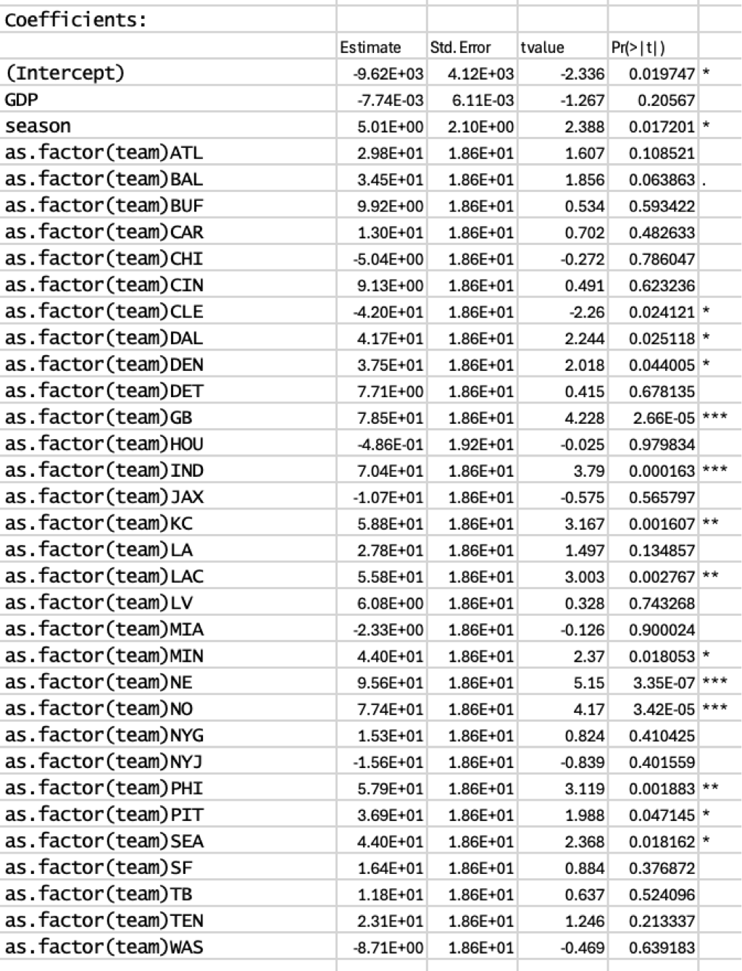
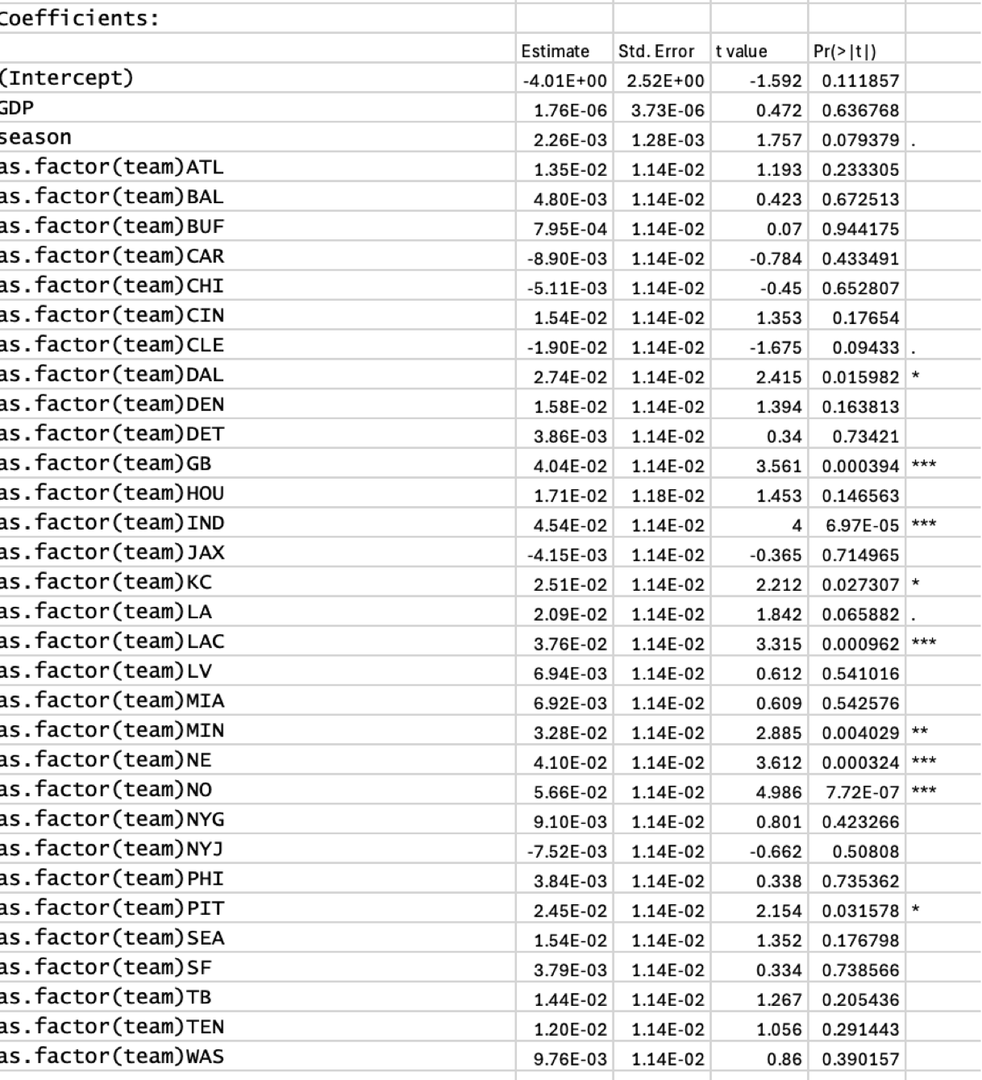
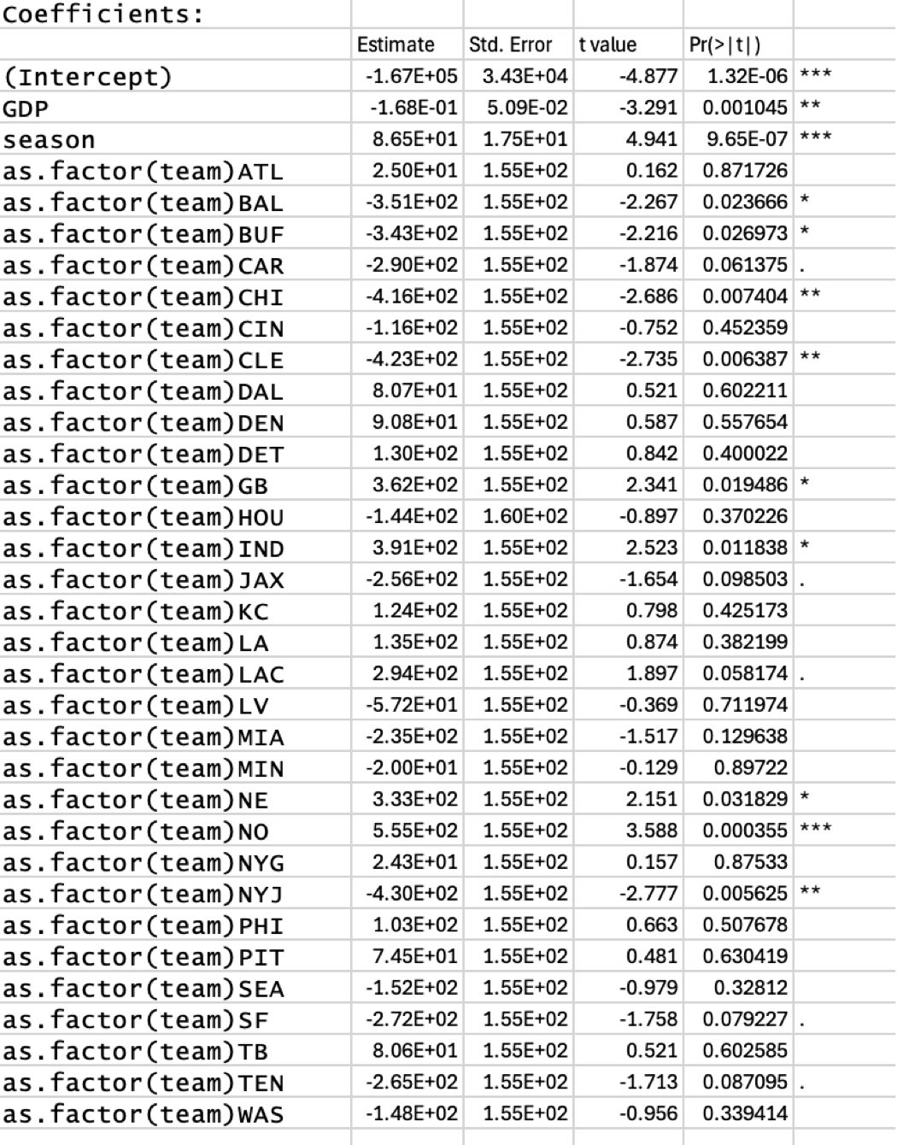
Might Be A Team Culture Issue
3
GDP + NFL

Slide 17
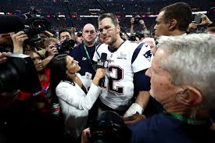
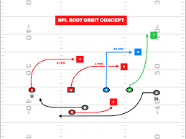
A Game of Less and Less Inches
3
Passing plays in Football are lagging indicators of the game, playbooks can contain up to 153 different plays
A decreasing GDP coefficient and increasing GDP factor can arguably indicate that the game may be so skilled that passing isn't having a chance to catch up
Defensives are too deceptive at disguising coverages and passing efficiency cannot keep up with
https://www.youtube.com/watch?v=n2_7dJ7DJDQ
GDP + NFL

Slide 18
So Does GDP Really Affect NFL Performance?
4
There are millions of factors that go into play when considering what affects the NFL's performance
However, we were able to find significant evidence that as the economy is increasing with respect to GDP, there is improved play throughout the NFL on an average and per team basis
A unique find was that we also found performance and ratings were up during times of economic crises
Thank you!

Slide 19
Sources
https://www.imf.org/en/Publications/fandd/issues/Series/Back-to-Basics/gross-domestic-product-GDP#:~:text=GDP%20measures%20the%20monetary%20value,the%20borders%20of%20a%20country
https://www.nfl.com/videos/how-nfl-players-are-training-during-the-covid-19-pandemic
https://data.scorenetwork.org/football/nfl-team-statistics.html
https://www.nfl.com/news/nfl-games-among-most-popular-shows-of-fall-09000d5d80def077
GDP + NFL

